Slide 1
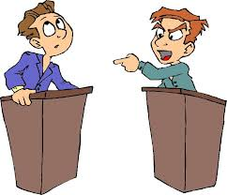

Controversial Issues

Slide 2
Controversial Issues
A controversial issue is something that is not agreeable with everyone. Some people are for the idea while others are against it.
Everyone on either side is convinced that they are right and that the other side is mistaken or too blind to see the truth.

Slide 3
Controversial Issues
A controversial issue is constituted by the difference in understanding a given statement, idea or concept.
Controversial issues include public opinion on a matter or option, a contention or a debate.

Slide 4
Controversial Issues
Locally the issue of gun control has created a controversy on the interpretation of the second amendment. On one end some people claim to have a right for keep and bear arms while the other side calls for regulation of guns by the state and federal bodies.

Slide 5
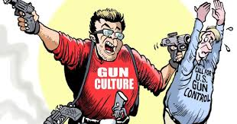

Gun Control

Slide 6
Controversial Issues
On the national level, the issue of abortion is a controversial issue that has raised a lot of debate. One side argues that the choice of terminating a pregnancy is a personal right while the other argues that abortion is morally wrong and should be put under government regulation.

Slide 7
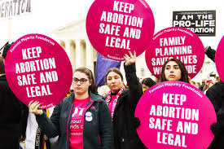
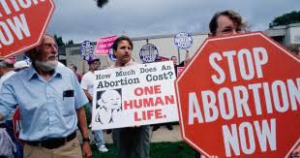
Abortion

Slide 8
Controversial Issues
Internationally, the issue of global climate change has sparked a lot of debate. Some are questioning whether global warming is real. If it is real, there are questions about human activity being the main cause. The controversy surrounding global climate change is one that many people, institutions and bodies have expressed their concerns about.

Slide 9
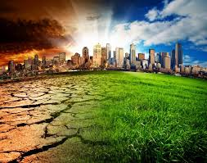

Global Warming

